Slide 1

Sales Analysis
by Rakhym Taskyn

Slide 2
Agenda
About Me & Power BI
My methodology of working with clients
Report:
Filters
Main Indicators&KPIs
Bar graphs
Map
Conclusion!

Slide 3
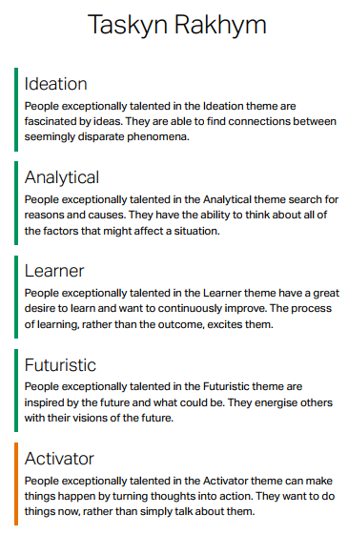
About Me
2009 High Secondary at Republic Physics-Mathematics school for gifted students
2012 Started Bachelor degree at SDU
2015 Database Administrator at SEMA Hospital
2016 Junior Backend developer at Techno Vision
2017 Master in Data Science Jamia National University India, New Delhi
2019 Project Manager at DEVA IT SOLUTIONS Noida, India
09/2019 Lecturer at SDU& KIMEP
2020 Part-time Data Analyst at Partner account
2021 Senior Data Scientist at Daryn Online

Slide 4
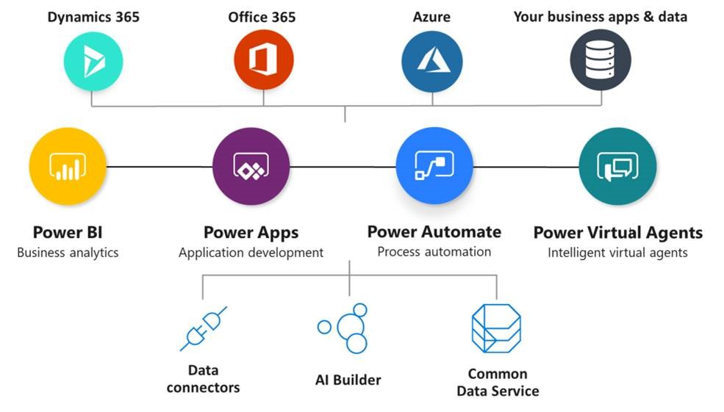
Power BI as a part of Power Platform

Slide 5
Steps for successful report creation
Understanding Customer needs and Business Process
Data consistency, accuracy and Building architecture of Database/Tables
Actual work on Visualization And Giving recommendations

Slide 6
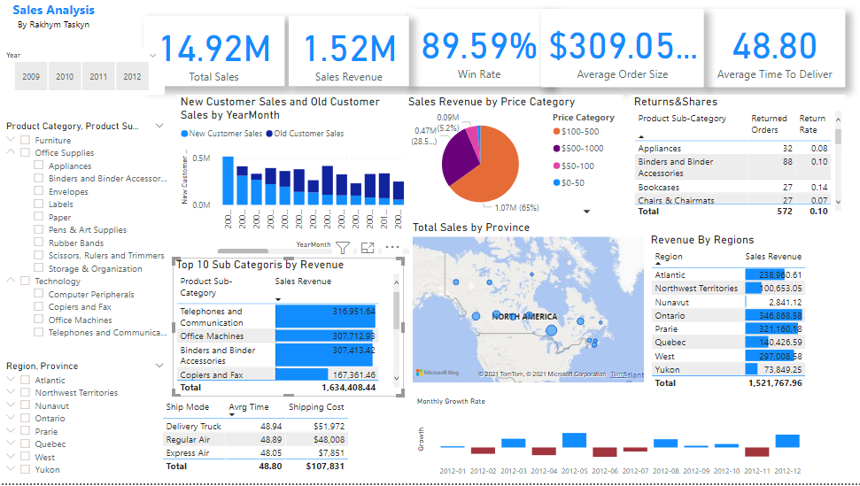

Slide 7
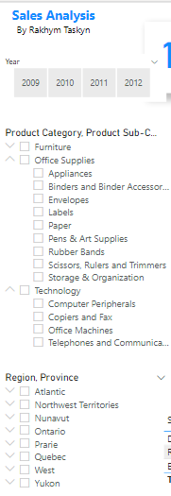
Left side bar of the dashboard is used for filtering
Numbers of filtering can be set up on filter side
Best practice is to keep main entities as a filters
Hierarchy filter are new features in Power Bi, makes filtering very convenient to interact.
Filters help to dynamically interact with report.

Slide 8

Top side header is used to demonstrate main metrics and KPIs
KPI can be defined by customer after first project demo
In most cases customers provide their own custom metrics to analyze their business
In my report I have leveraged commonly used measures like “Total Revenue”, “Win Rate” etc.

Slide 9
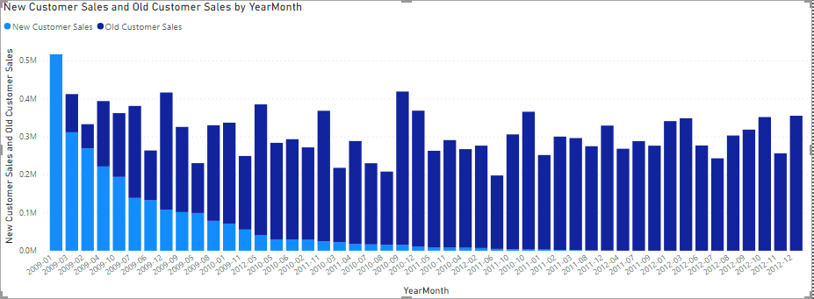
If Customers purchase difference is more than one month, then he/she is old customer.
Recommendations:
Company should increase loyalty programs because, last year only new clients are purchasing.
Lack of old clients will negatively effect on brand equity
New clients cost extra financial resources for the organization.

Slide 10
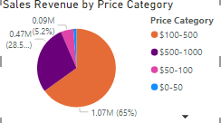
In this visual, products unit prices are categorized manually. It shows that products with price between 100$ and 500$ make almost 2/3 of revenue. Possible lesson can be learned: pay more attention to other price sector to increase revenue proportionally and security on the market. Because Only diversification will give the availability for avoiding the risks.

Slide 11
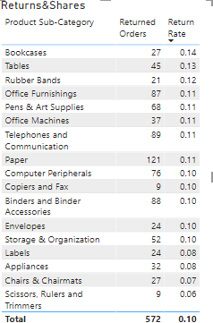
Table show different subcategories of products with return number and return rate. Excellent exercise will be to investigate return cases for each product categories: Why orders were returned? What action are taken after customer returned the items.
Especially there should be observation about which products whose return rate is > 10%
Because Returned products:
Decreases Brand equity
Extra outcomes for the organisation

Slide 12
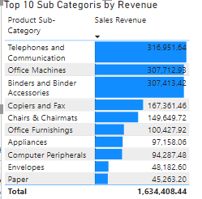
In spite of diversification of the market, Pareto’s 80/20(80% sales come from 20% products) low play role on the market.
Rest of the 80% product which is responsible for 20% sales works for increasing the showcase.
Organization should pay more attention on sales of electronic devices.

Slide 13
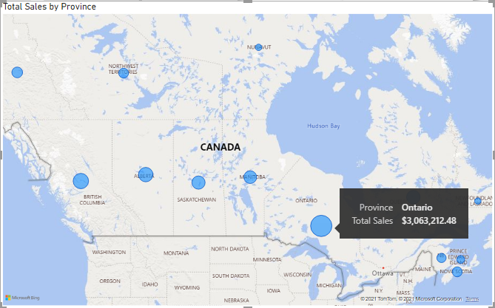
Map gives us immense opportunity to visualise the sales by regions

Slide 14

Shipping mode comparison shows that there are no significant difference in average delivery time, however, shipping cost are expensive for Delivery truck and Regular air.
The best choice of transportation for the company is Express air, which gives the minimum delivery time and approximately 7 times cheaper price.

Slide 15
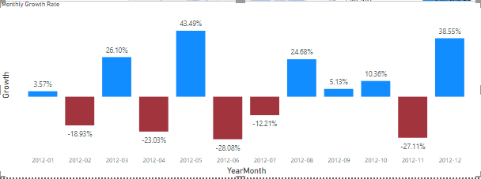
Monthly Sales Growth Rate is comparison of each month with previous calendar month.
By observing 5 years data we can predict the volume of sales by months and seasons.

Slide 16

In Conclusion
Overall, sample dataset does not give opportunity to show all of my performance in DAX.
In real life task I use my skills from Machine learning to give more precise future predictions.
Real life datasets are more complex, as the data can be gathered and extracted from different sources in various types.
Best practice is to provide demo visuals for customer in order to provide new ideas. After customer internally can decide which metrics and KPI’s are important for them.
In my dashboards, I use minimalistic in design to avoid confusion.

Slide 17

Thank you for your attention!!
Best regards: MSC Rakhym Taskyn

